Slide 1
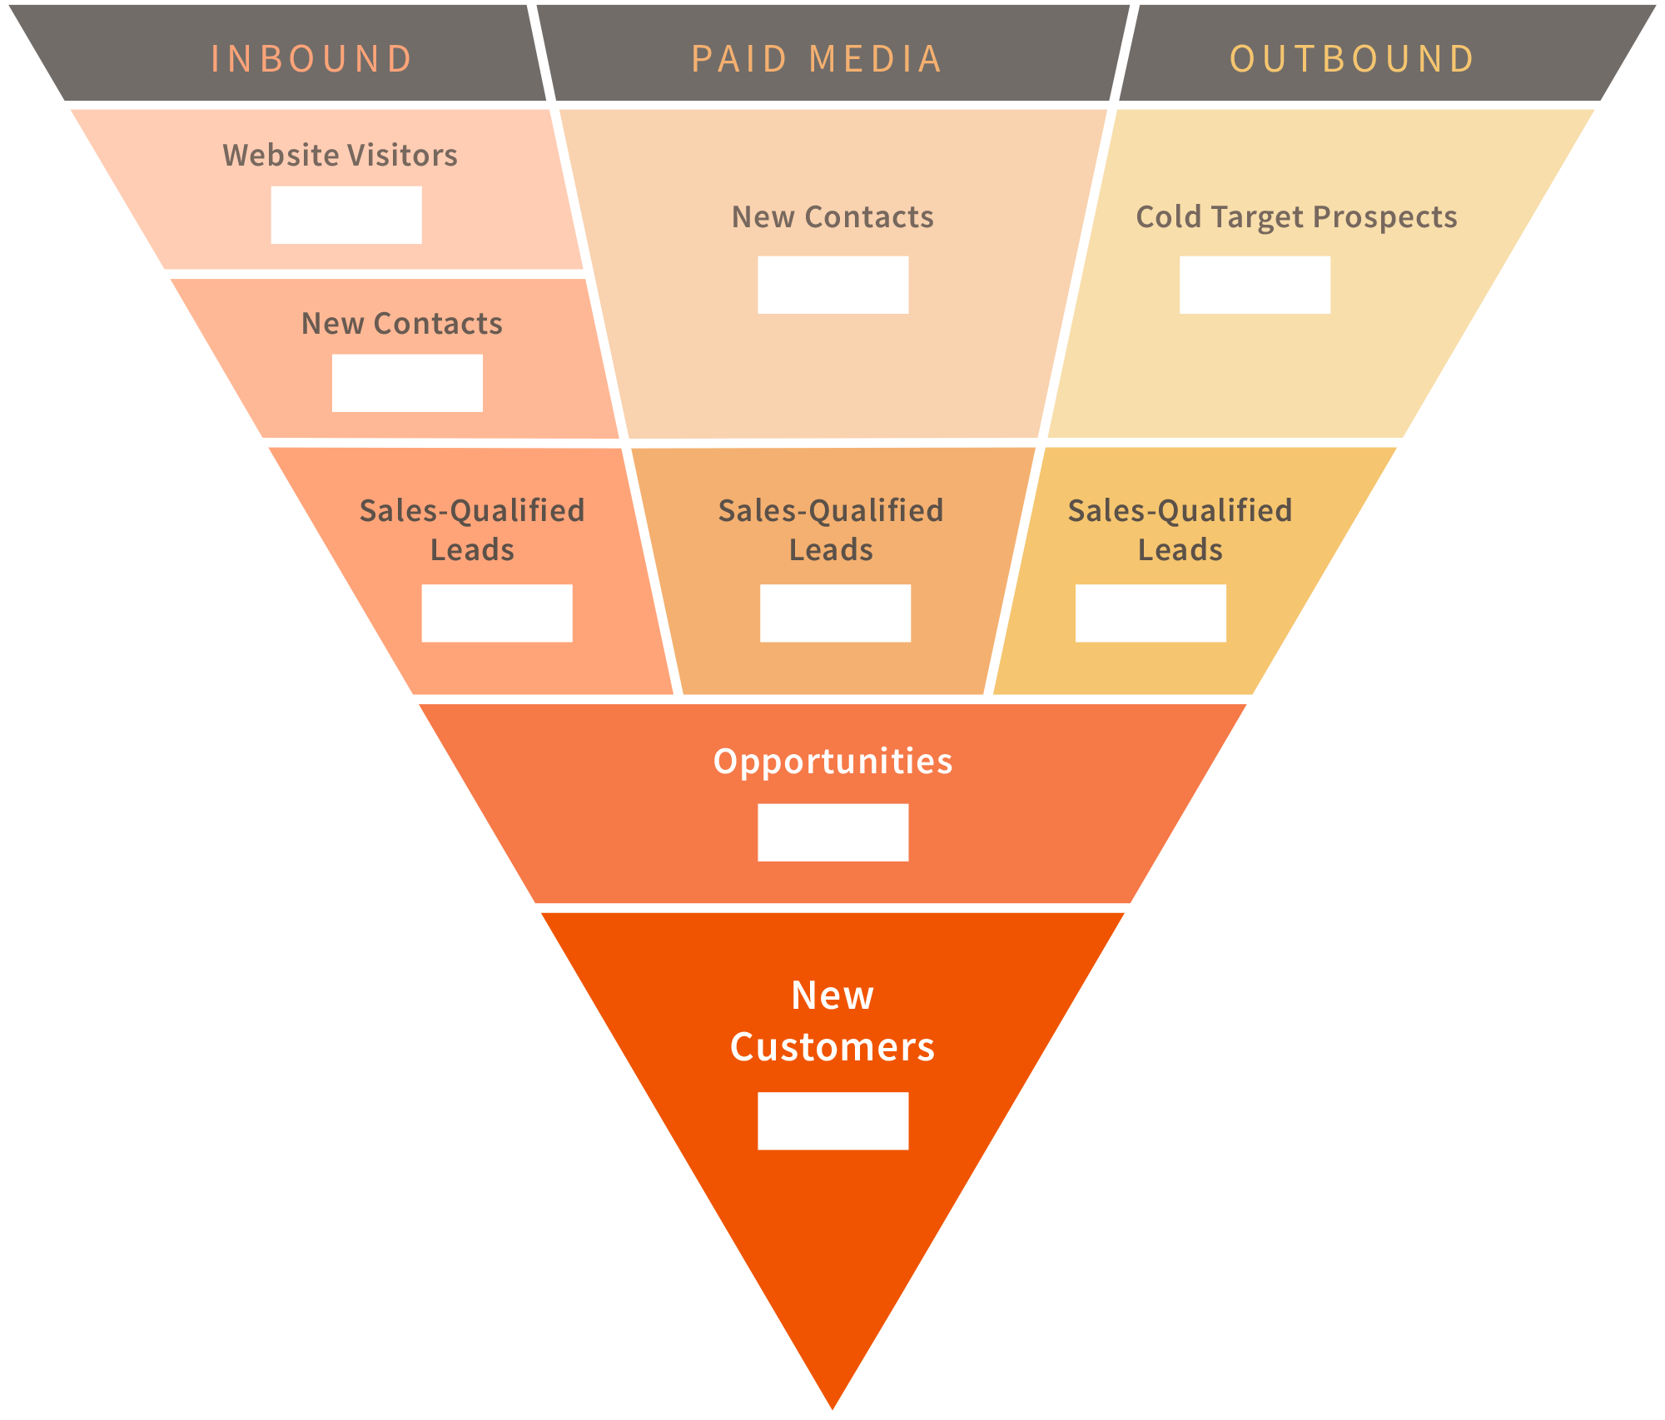
0
0
0
0
0
0
0
0
0

